Slide 1
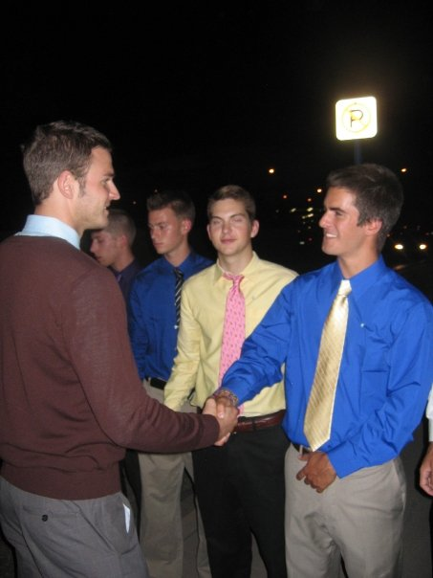
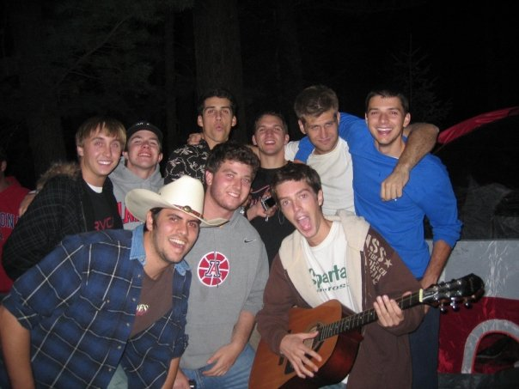
Sigma Chi
ΣΧ
At the University of Arizona

Slide 2
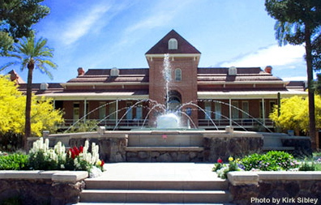
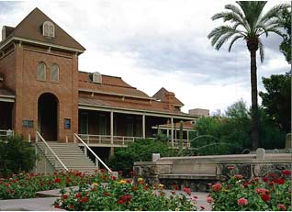
Overview
Our colony was founded on August 24th, 2007
Since then, we have grown to include 58 members.
We have completed three of the four steps of colonization. We intend on completing the last step, our Formal Petition, in early November
We are engaged in a full time multimillion dollar capital campaign for the construction of a new house on our lot at First and Vine.
We have held numerous community service, philanthropy, social, faculty and brotherhood events since our founding.
Notes:
Introduce the chapter to IFC.

Slide 3
Mission Statement
The Beta Phi colony is committed to upholding the values of Friendship, Justice, and Learning. Through aggressive targeted recruitment, a comprehensive pledge education program, an emphasis on community service, and keeping in mind their legacy, they plan to establish a true values-based, leadership fraternity that will have permanent and influential presence at the University of Arizona.

Slide 4
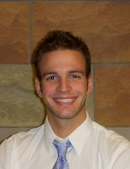
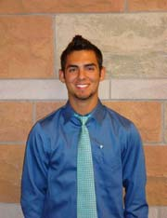
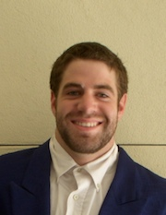
Members
Some statistics
We have had roughly 20 pledges complete our pledge program each semester
Sigma Chi’s at UA have come from all walks of life. Our ranks include an ASUA senator, an Icecat, a local DJ, the lead singer of a local rock band, the Vice Wing Commander of the Air Force ROTC, a hasher for G-phi, rugby players, 4.0 students, students studying engineering, anthropology, physics, among others.
Every member of Sigma Chi is involved with at least one extracurricular activity
We have the 2nd highest cumulative GPA among all male fraternities within IFC

Slide 5
Colonization
Since the Fall of ’08 we have strategically and methodically moved towards reestablishing our chapter.
Sigma Chi HQ has strict requirements for expansion chapters
Benchmarks
Declaration of Intent (11/07)
Phase One Report (4/08)
Phase Two Report (9/08)
Formal Petition (expected 11/08)
Initiation (tentatively set for early March)
Notes:
Briefly discuss the colonization process

Slide 6
Our New Chapter House

Slide 7
The Capital Campaign
Since Fall of ‘08, we in conjunction with our Housing Corporation have been engaged in a 4.5 million dollar capital campaign
Our lot is at First and Vine St., across from the ADPi house. It is currently a parking lot.
Despite the economic downturn, to date we have managed to raise almost half of our goal.

Slide 8
Sigma Chi Programs
To date:
The Sigma Chi Campus Involvement Drive
Annual Drive for Dreams™ invitational golf tournament
Balfour Leadership Workshop
MISSION 365 Recruitment program
Derby Days (coming Spring ‘09!)
ΣX Mentor Program
Merit Scholarship Program
Sweetheart of Sigma Chi (coming this semester!)
Sigma Chi Votes 2008

Slide 9
Community Service
This semester our Chapter is proud to announce a partnership with the new Diamond Children center’s Steele Foundation. We hope to hold two events each semester developing a relationship and serving the children in the terminal cancer ward. Our first service with them is in two weeks, a pumpkin carving event for Halloween.

Slide 10
Conclusion
We would be honored to become a full member of the Interfraternity Council at the University of Arizona. It is our belief that we will be a positive addition to Greek life, and that we have much to offer our campus, community, and beyond with our emphasis on excellence in leadership, philanthropy, and academics.
Thank you for your time.

